Slide 1
Predicting whether a person is a voter or non-voter in america
Barrett Nibling
bnibling@gmail.com

Slide 2
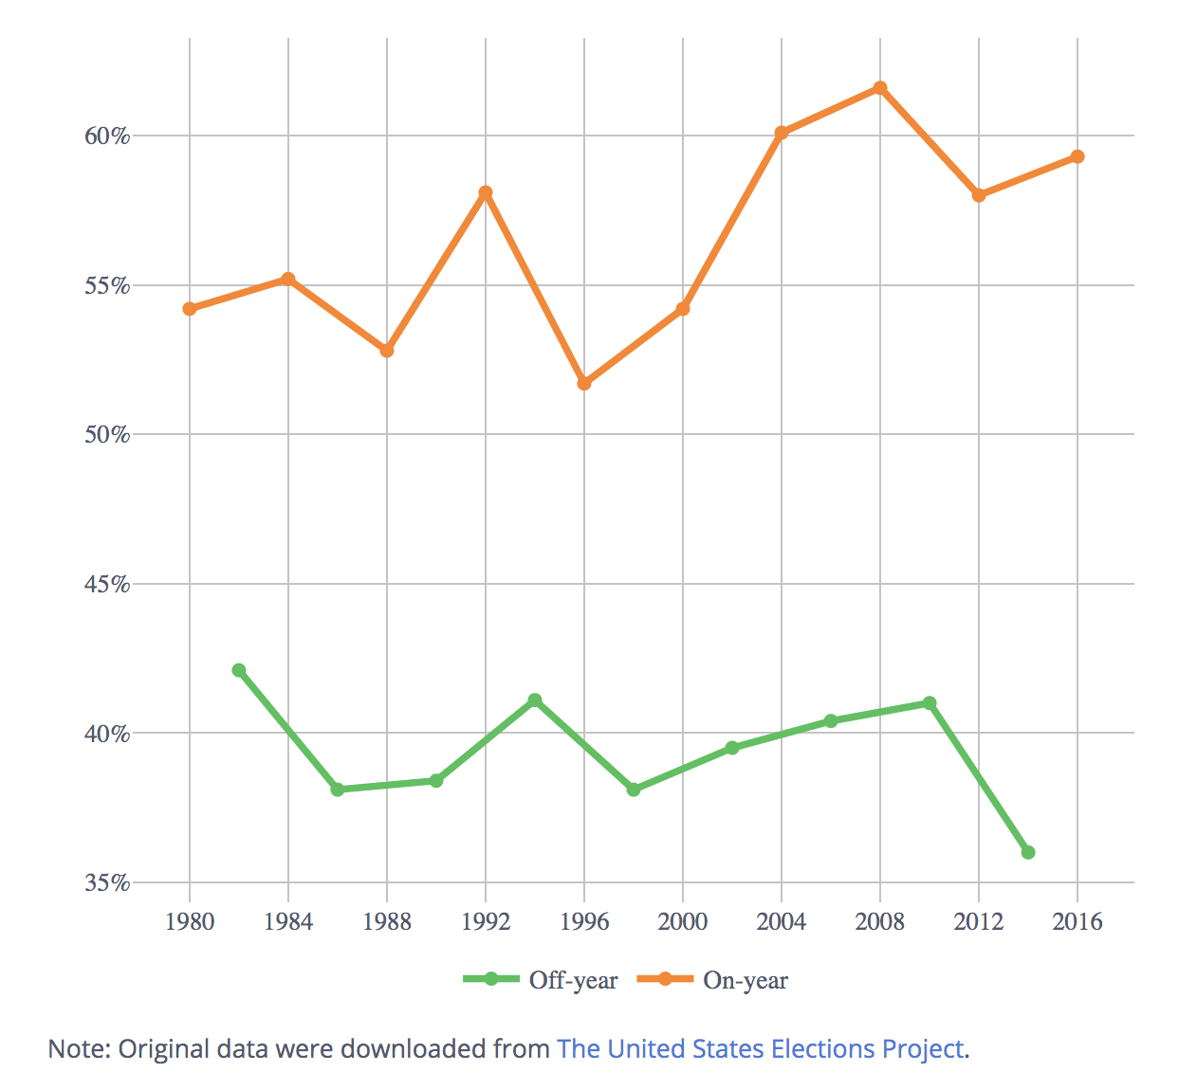
Voter turnout
Best measure of the health of the electoral process
35-60% eligible voters don’t vote
Can metrics determine if someone will vote or not?
Courtesy of The United States Elections Project: http://www.electproject.org/home/voter-turnout/voter-turnout-data

Slide 3

Why many Americans don’t vote.
Various demographics
Barriers to voting
Trust in the system
Beliefs about politics
https://projects.fivethirtyeight.com/non-voters-poll-2020-election/

Slide 4
FiveThirtyEight- Non-Voters Data
Polling done by Ipsos
Conducted from Sept. 15 to Sept 25
5,239 respondents matched voter file records by Aristole (5,836 used)
Surveyed on 33 topics
Basic demographic data
Voter Categories
always: Voted in all or all-but-one eligible elections
sporadic: Voted in at least 2, but fewer than all-but-one eligible elections
rarely/never: Voted in 0 or only 1 eligible election
https://github.com/fivethirtyeight/data/tree/master/non-voters

Slide 5
MethodS
Random Forest Regression
Gradient Boosting
XGB

Slide 6
Questions
When compared to non-swing states, do swing states show a significant difference in job postings and employment levels?
(i.e. Is there a causation between being a swing state and these variables?)
When compared to each other, do these swings states differ from each other in job postings and employment levels?
(i.e. Which swing states are most affected by these variables?)

Slide 7
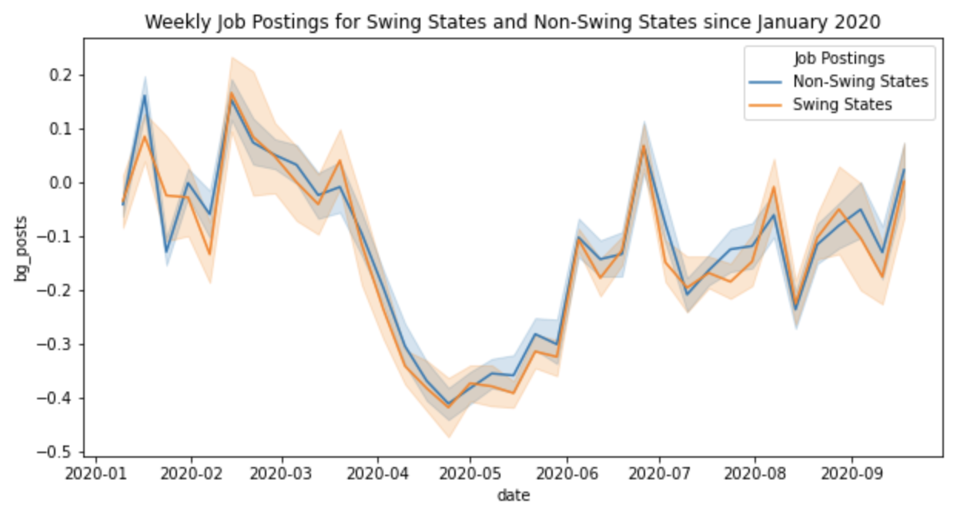
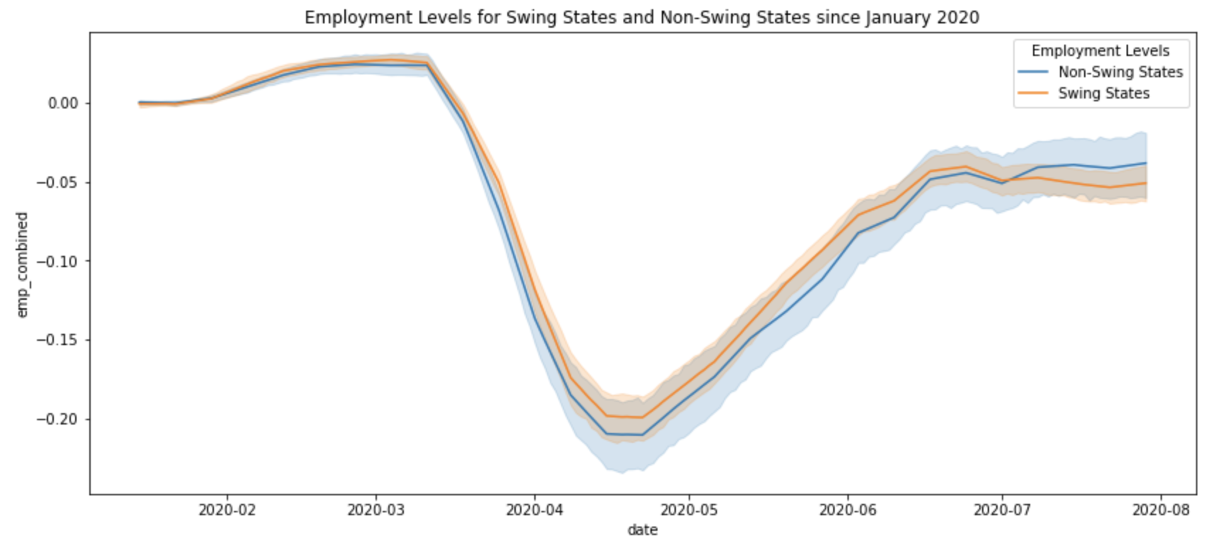
1. Swing vs non-swing
Job Postings Data:
Normally distributed (parametric testing)
P-values: 0.277 with Standard t-test, 0.249 with Welch's t-test
No significant difference
Employment Levels Data:
Not normally distributed (non-parametric testing)
P-values: 0.367 with Mann-Whitney U test, 0.734 with Kruskal test
No significant difference

Slide 8

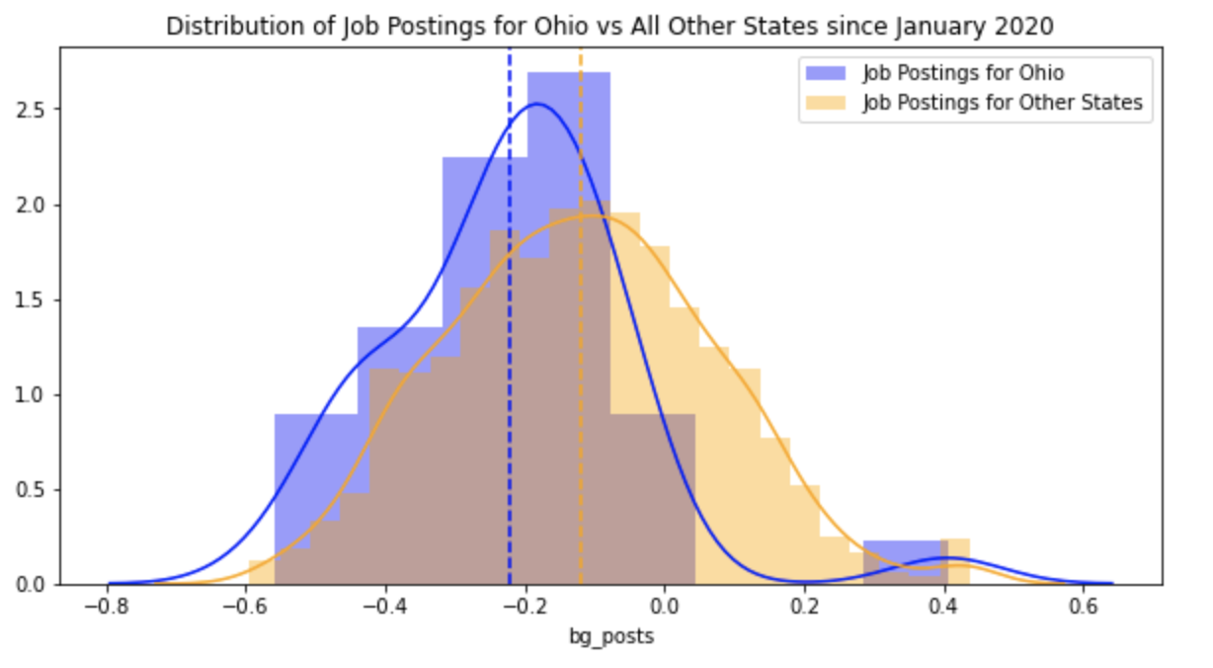
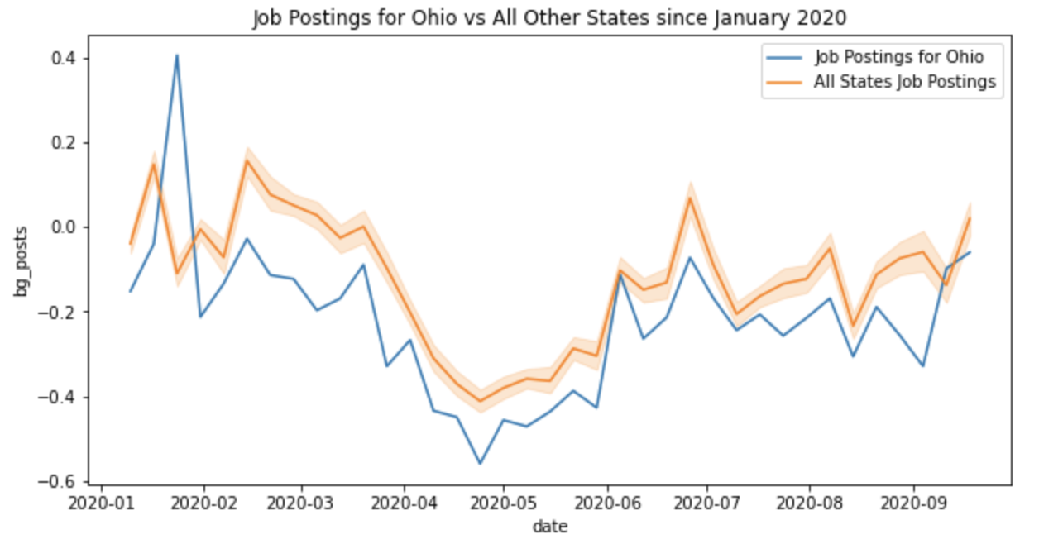
2. Swing vs swing: Job Postings Data
Normally distributed (parametric testing)
P-value with One-way ANOVA = 0.0166
At least one significant difference
P-values with Tukey’s HSD
Most values greater than 0.05
Ohio-Georgia = 0.0091
Ohio-Iowa = 0.0145
Only Ohio showed significant difference with two other swing states
Ohio is 4th worst in terms of job postings in the entire US

Slide 9
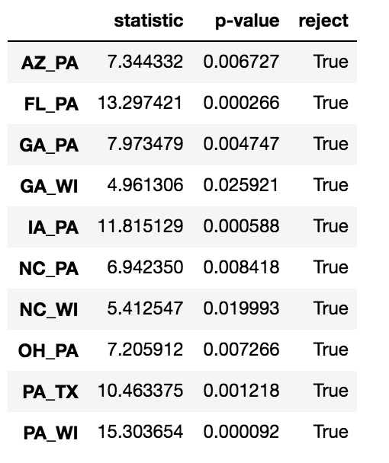
2. Swing vs swing: Employment Levels Data
Not normally distributed (non-parametric testing)
P-values with Kruskal test (see chart)
Most values greater than 0.05
Wisconsin-Georgia & Wisconsin-N. Carolina ≈ 0.02
Pennsylvania-All other swing states < 0.01
Pennsylvania is a clear outlier among swing states
Suffered a more severe drop in employment levels than other swing states

Slide 10
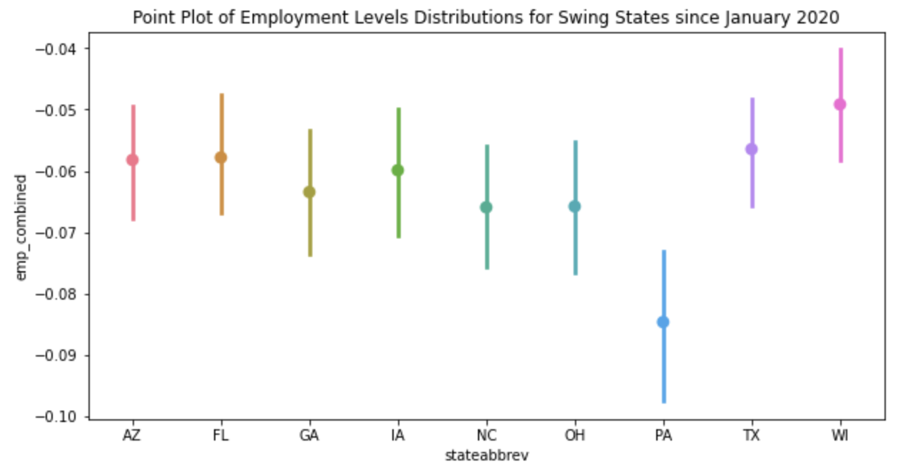
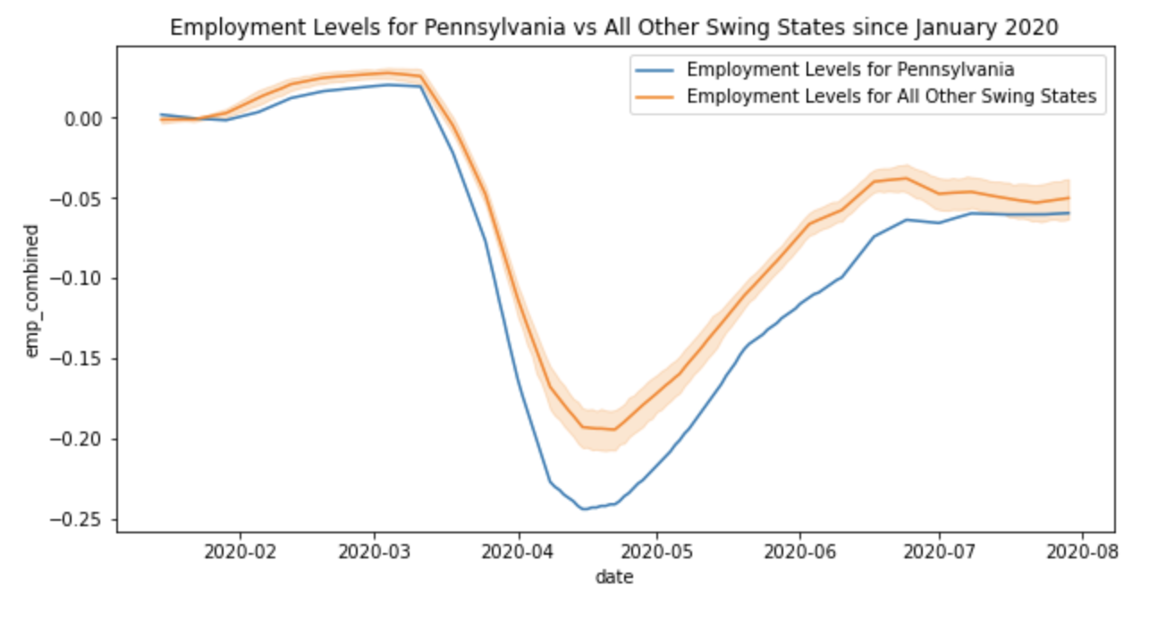
Swing vs swing: Employment Levels Data
Employment Levels in Pennsylvania are on average lower than the other swing states in terms of overall distribution and in terms of yearly trends.

Slide 11
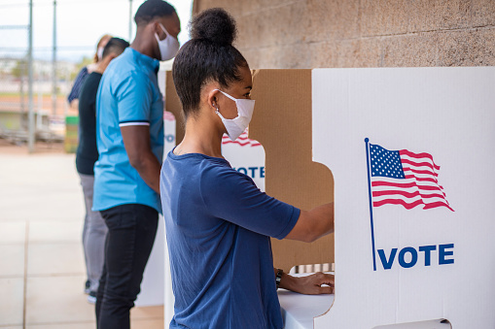
Conclusion
As Political Party Operative, inference is necessary to target potential voters
Resources are thin, so concise and tactful campaigning is critical to win swing states
Knowing the concerns of voters and how the data matches those concerns is key

Slide 12

Recommendations
Ohio low job postings:
Advertisements displaying promises to increase the number jobs
Pennsylvania low employment levels:
Campaign strategies that illustrate clear plans to retain jobs in industries most affected by COVID

Slide 13

Future Considerations
Explore different aspects of both job postings and employment levels
- Demographics, Industries, Wages, etc.
Explore the relationship between job postings and employment levels
Look outside of 2020 for perspective

Slide 14
Thank you for listening
Barrett Nibling
bnibling@gmail.com

Slide 15
Additional slides

Slide 16
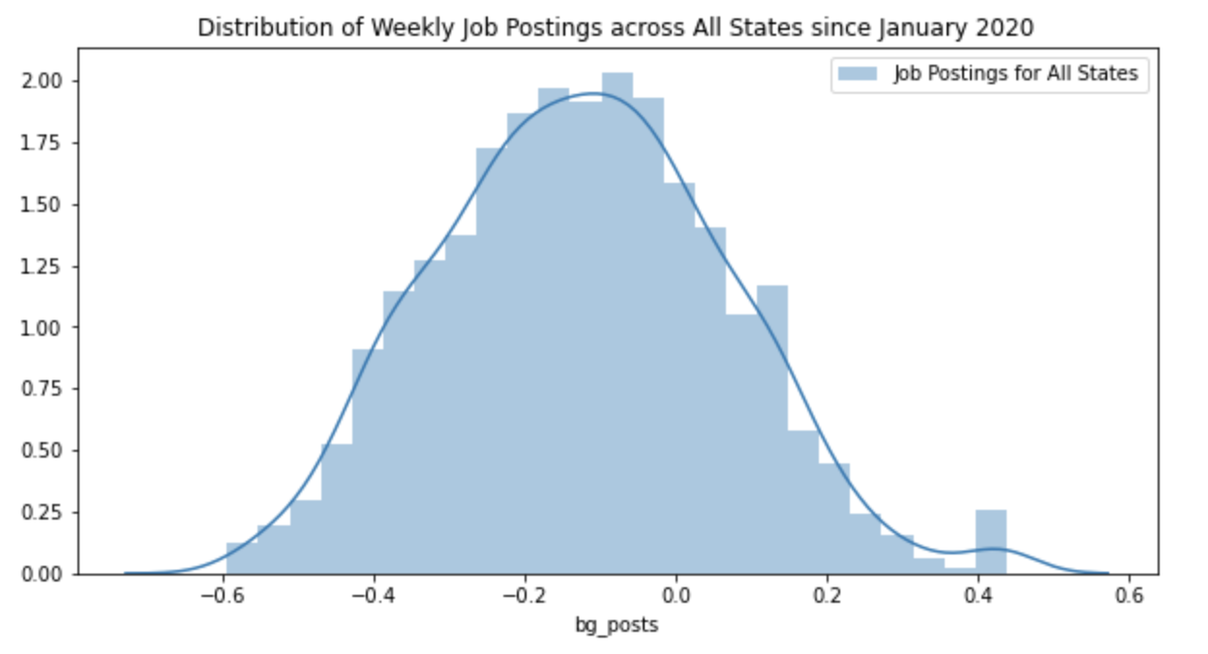
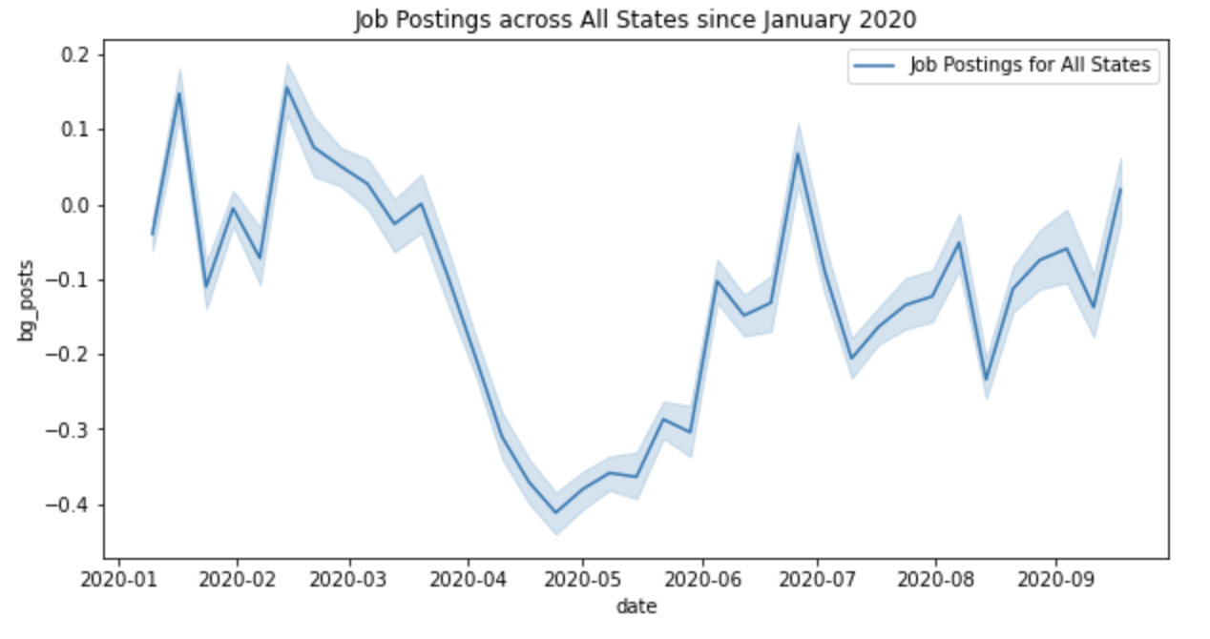
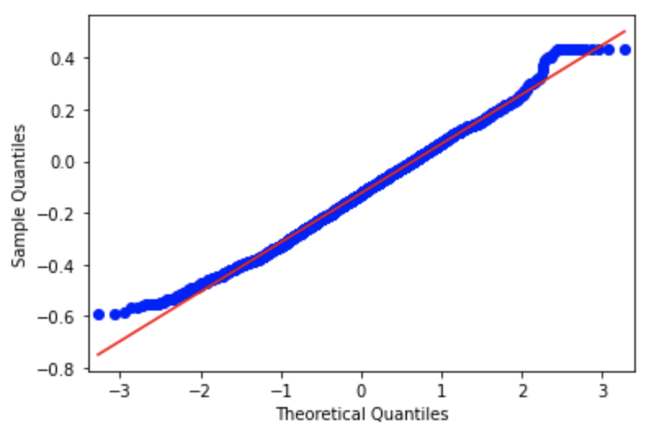
Job postings across all states

Slide 17
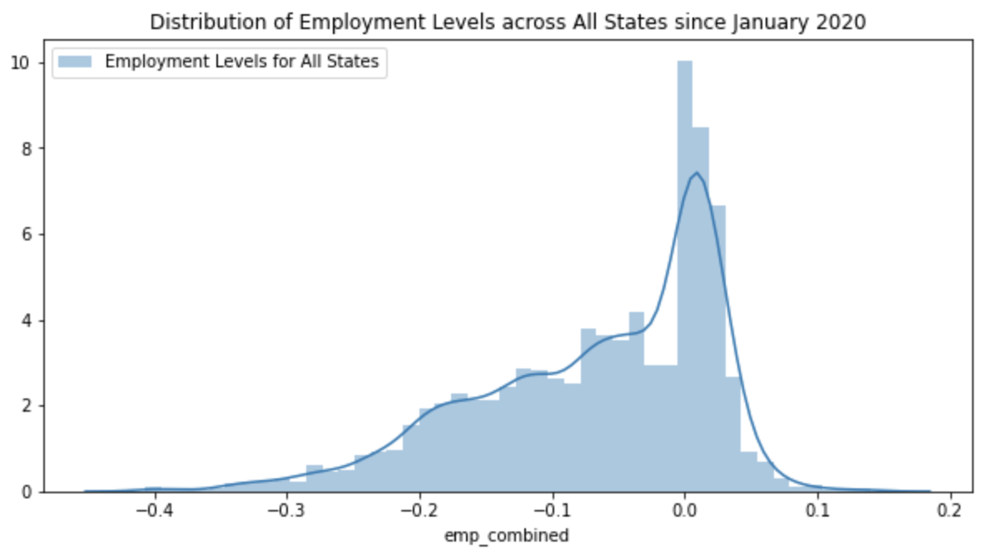
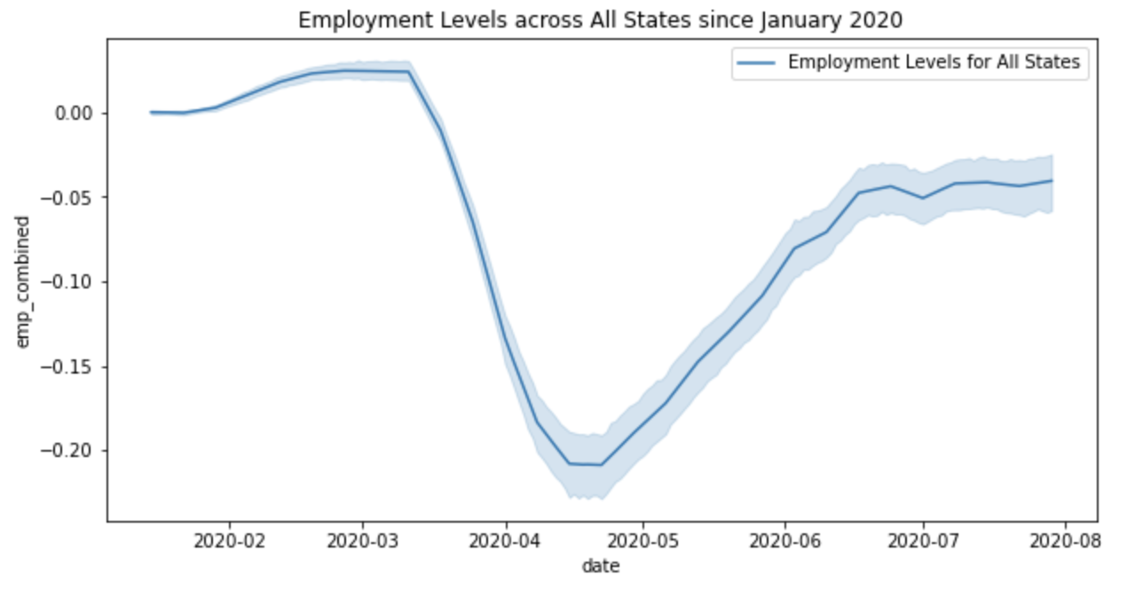
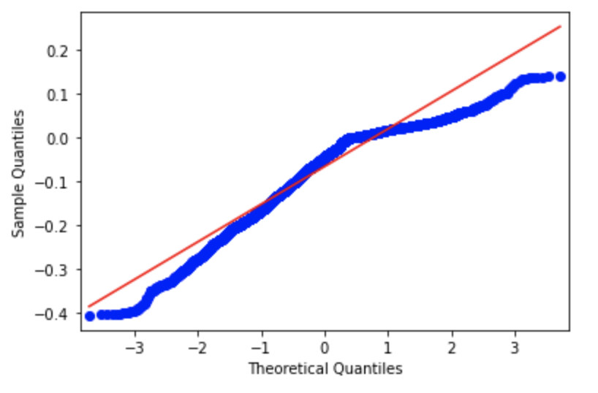
Employment levels across all states

Slide 18
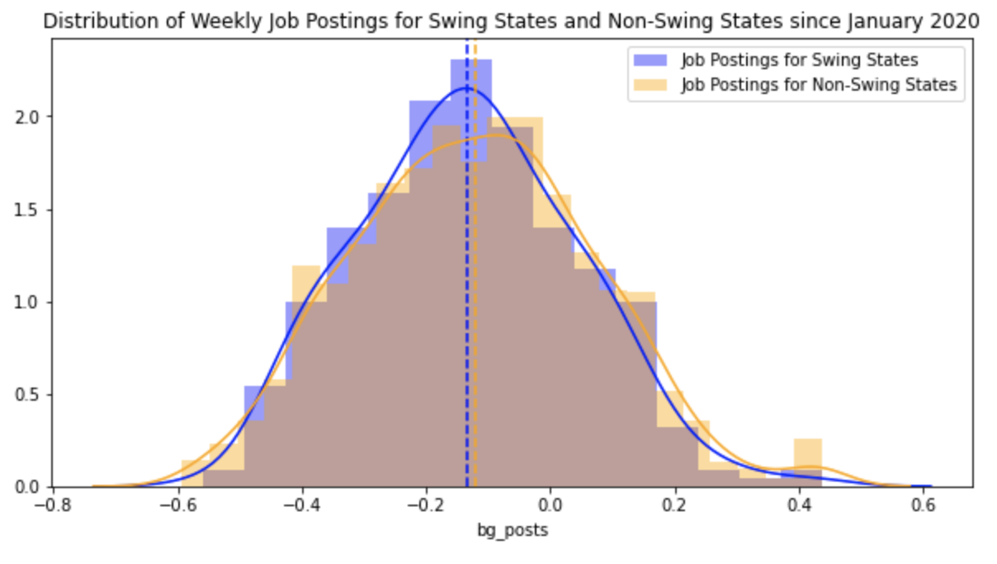
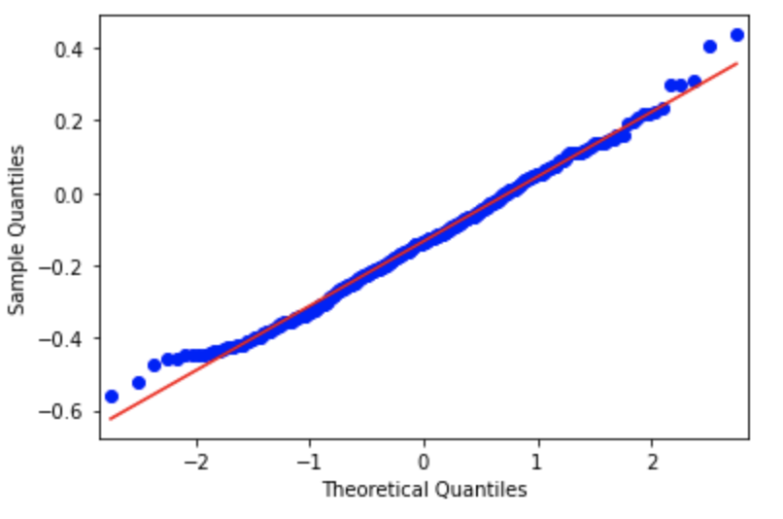
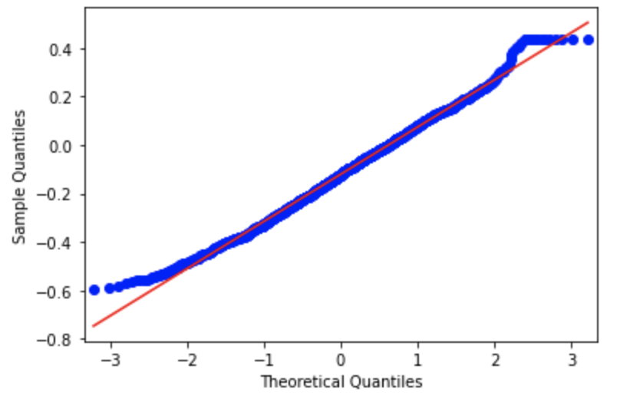
Job postings Swing vs non-swing

Slide 19
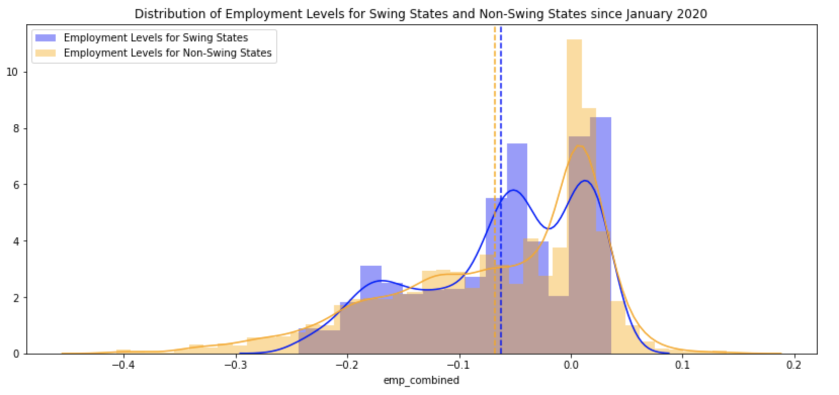
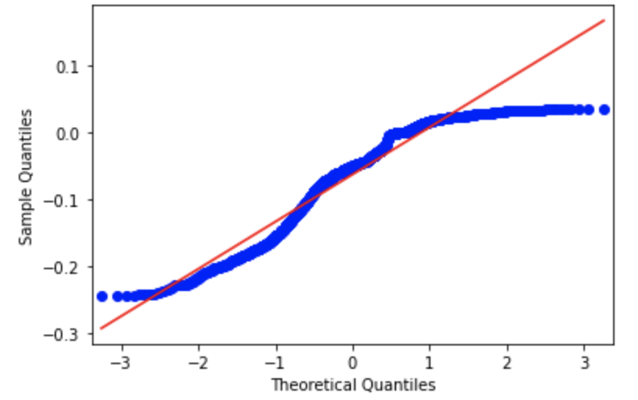
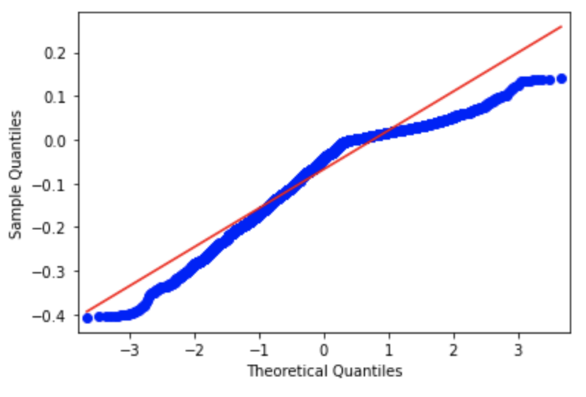
Employment levels swing vs non-swing

Slide 20
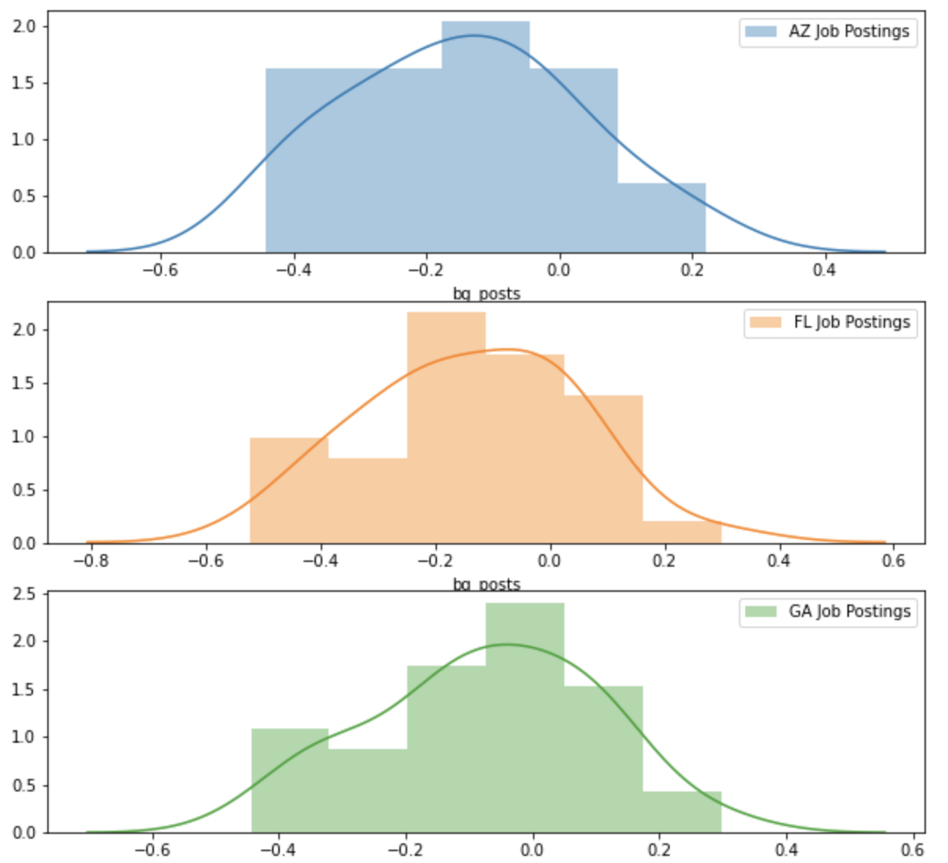
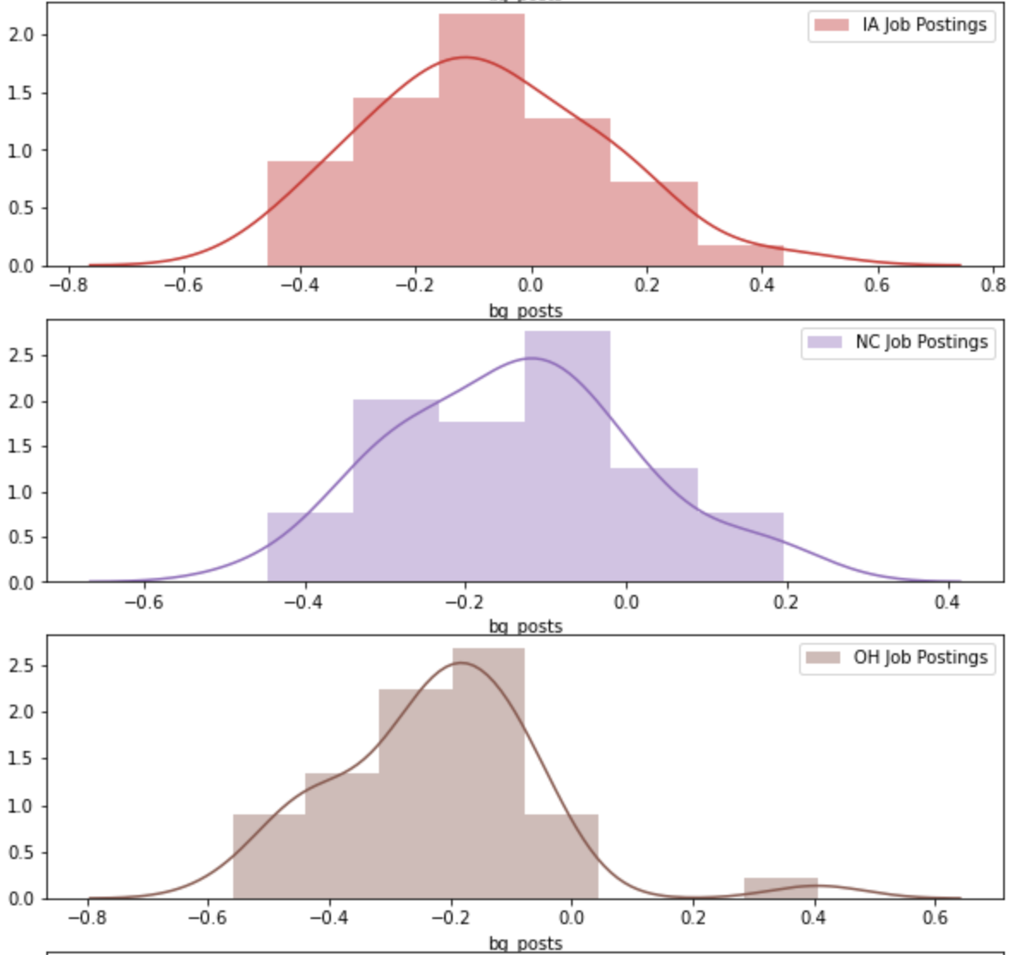
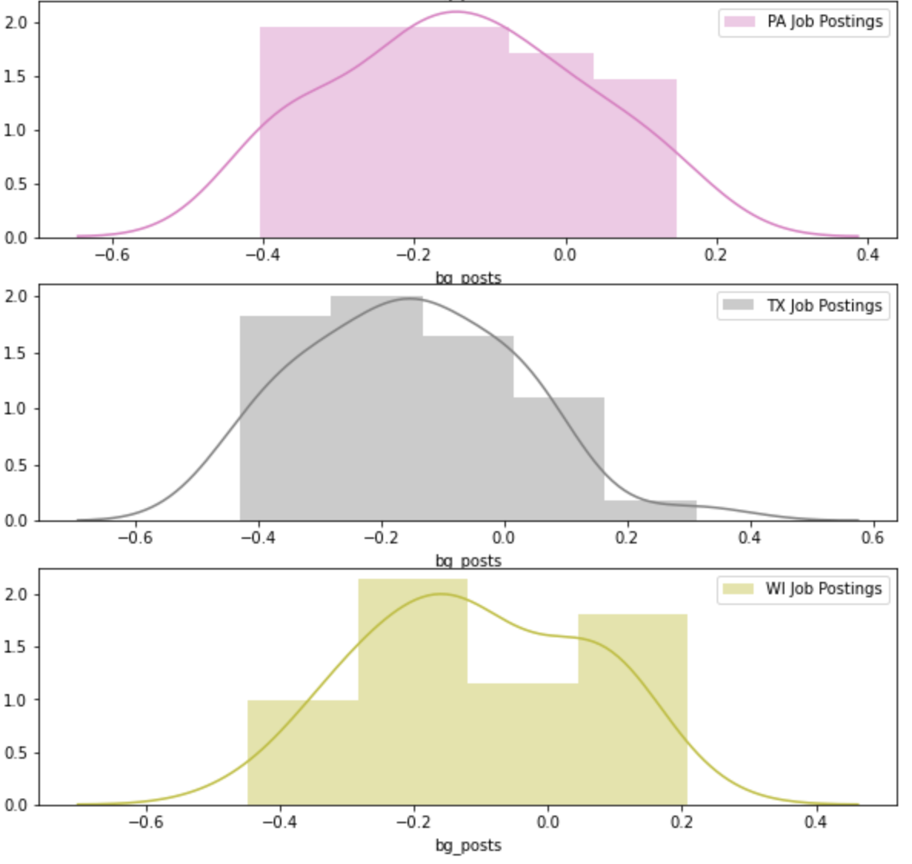
Job postings Swing vs swing

Slide 21
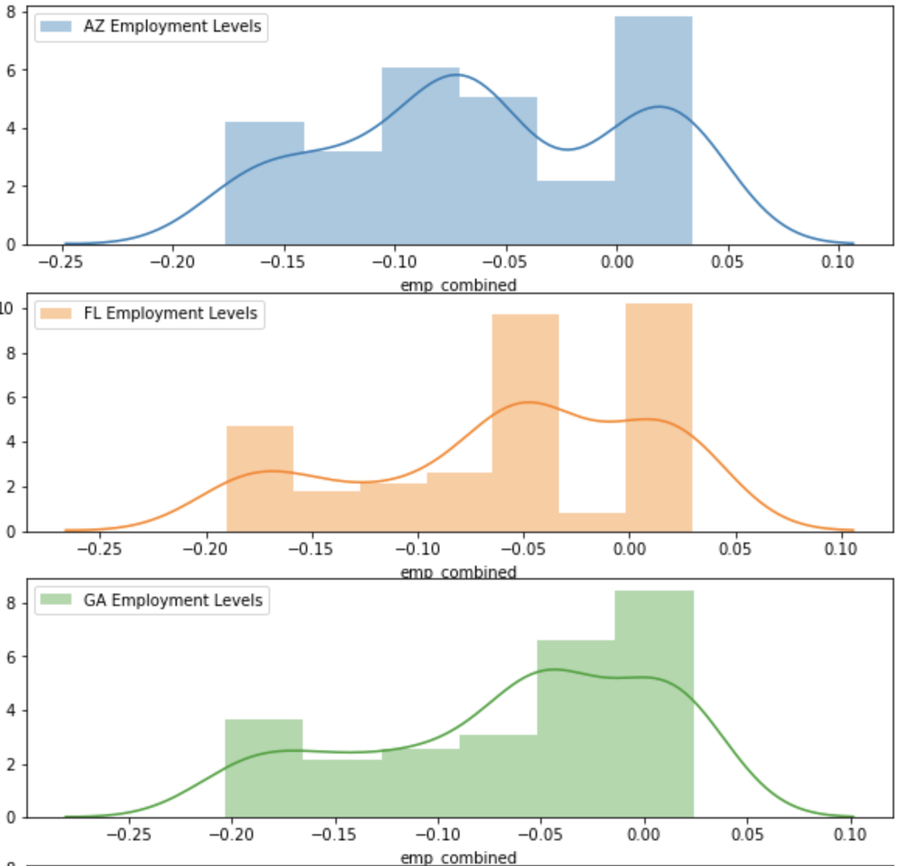
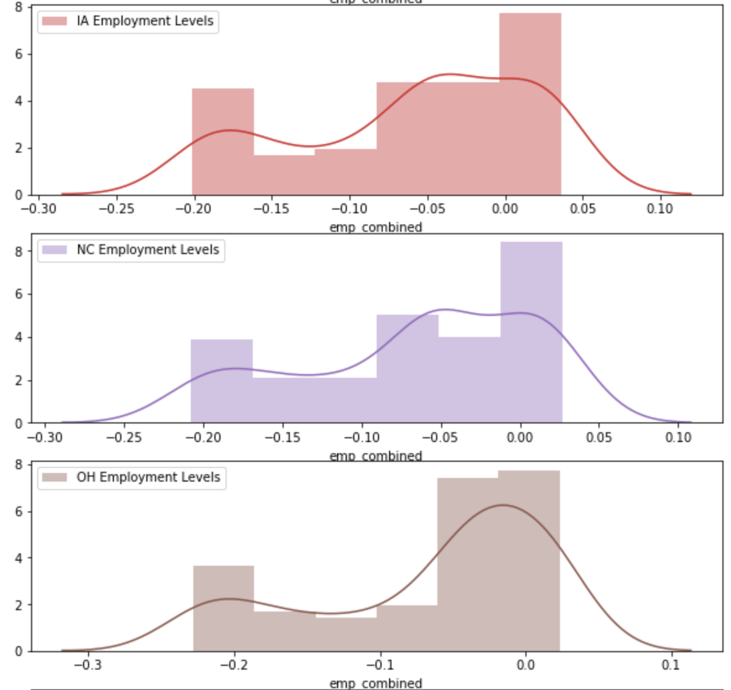
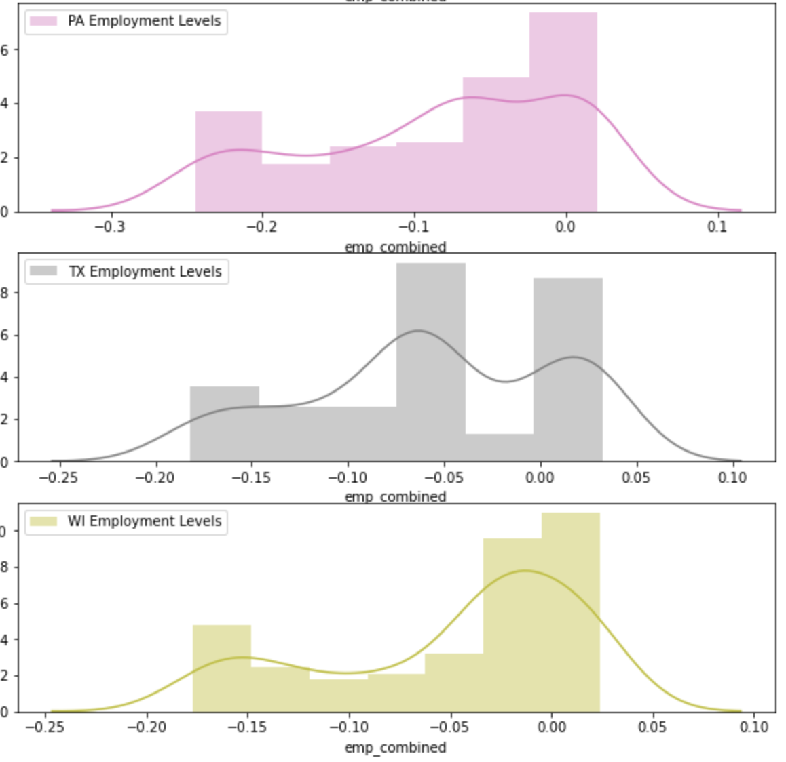
Employment levels Swing vs swing

